Slide 1
DevOps
Lesson 02 Introduction to Cloud
Notes:
Add instructor notes here.

Slide 2
Lesson Objectives
To understand the following topics:
What is Cloud
What is Cloud Computing
Deployment Models
Cloud Computing Services
Advantages
Disadvantages
Cloud Storage
DevOps and Cloud
Notes:
Add instructor notes here.

Slide 3
2.1: What is Cloud Introduction
What is Cloud ?
Cloud provides us a means by which we can access the applications as utilities, over the internet
The term cloud refers to a Network or Internet
Cloud is something which is present at remote location
E.g. Yahoo!, GMail, Hotmail ,WAN,LAN,VPN–
Instead of running an e-mail program on our computer, we log in to a Web e-mail account remotely.
The software and storage for our account doesn’t exist on our computer –
it’s on the service’s computer cloud.

Slide 4
2.2: What is Cloud Computing Cloud Computing
What is Cloud Computing ?
Cloud Computing refers to manipulating,configuring,and accessing the applications online.
It offers online data storage, infrastructure and application.
Cloud Computing is both a combination of software and hardware based computing resources delivered as a network service.

Slide 5
2.3: Deployment Models Deployment Models
Deployment models define the type of access to cloud, i.e. how the cloud is located?
Private Cloud
Public Cloud
Community Cloud
Hybrid Cloud

Slide 6
2.3: Deployment Models Deployment Models
There are four different cloud models
Private Cloud: The Private Cloud allows systems and services to be accessible within an organization. It offers increased security because of it’s private nature
Community Cloud: The Community Cloud allows systems and services to be accessible by group of organizations
Public Cloud: The Public Cloud allows the systems and services to be easily accessible to the general public. Public cloud may be less secure because of it’s openness.
Hybrid Cloud: The Hybrid Cloud is a mixture of public and private cloud.However,the critical activities are performed using private cloud while non-critical activities are performed using public cloud
Notes:
Cloud can have any of the four types of access:
Private Cloud: Here, computing resources are deployed for one particular organization. This method is more used for intra-business interactions. Where the computing resources can be governed, owned and operated by the same organization.
Community Cloud: Here, computing resources are provided for a community and organizations.
Public Cloud: This type of cloud is used usually for B2C (Business to Consumer) type interactions. Here the computing resource is owned, governed and operated by government, an academic or business organization.
Hybrid Cloud: This type of cloud can be used for both type of interactions - B2B (Business to Business) or B2C ( Business to Consumer). This deployment method is called hybrid cloud as the computing resources are bound together by different clouds.

Slide 7
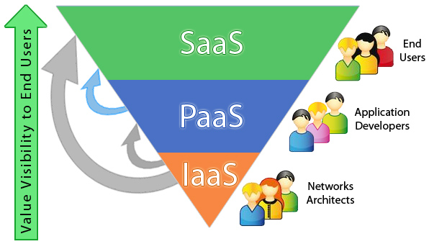
2.4: Cloud Computing Services Cloud Computing Services
The three major Cloud Computing Offerings are
Software as a Service (SaaS)
Platform as a Service (PaaS)
Infrastructure as a Service (IaaS)

Slide 8
2.4: Cloud Computing Services Infrastructure as Service(IaaS)
It provides access to computing resources in a virtualized environment “the cloud” on internet
It provides computing infrastructure like virtual server space, network connections, bandwidth, load balancers and IP addresses
Notes:
IaaS(Infrastructure as a service) is a complete package for computing. For small scale businesses who are looking for cutting cost on IT infrastructure, IaaS is one of the solutions. Annually a lot of money is spent in maintenance and buying new components like hard-drives, network connections, external storage device etc. which a business owner could have saved for other expenses by using IaaS.

Slide 9
2.4: Cloud Computing Services Platform as a Service(PaaS)
It provides a platform and environment to allow developers to build applications and services
This service is hosted in the cloud and accessed by the users via Internet
It provides all of the facilities required to support the complete life cycle of building and delivering web applications and services entirely from the internet
Notes:
PaaS services are constantly updated & new features added. Software developers, web developers and business can benefit from PaaS. It provides platform to support application development. It includes software support and management services, storage, networking, deploying, testing, collaborating, hosting and maintaining applications.

Slide 10
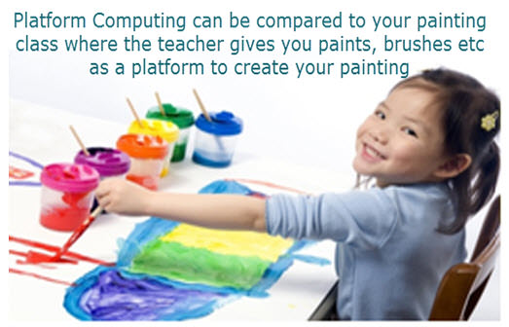
2.4: Cloud Computing Services Platform as a Service(PaaS)
To understand in a simple terms, compare this with painting a picture, where you are provided with paint colors, different paint brushes and paper by your school teacher and you just have to draw a beautiful picture using those tools.

Slide 11
2.4: Cloud Computing Services Software as a Service(SaaS)
SaaS model allows to use software applications as a service to end users
Here the applications are hosted by a vendor or service provider
and are made available to customers over a network (internet)
Anyone who needs an access to a particular piece of software can be subscribed as a user
SaaS is compatible with all internet enabled devices.
Notes:
Traditionally, software application needed to be purchased upfront &then installed it onto your computer
SaaS users on the other hand, instead of purchasing the software subscribes to it, usually on monthly basisvia internet.
Many important tasks like accounting, sales, invoicing and planning all can be performed using SaaS.

Slide 12
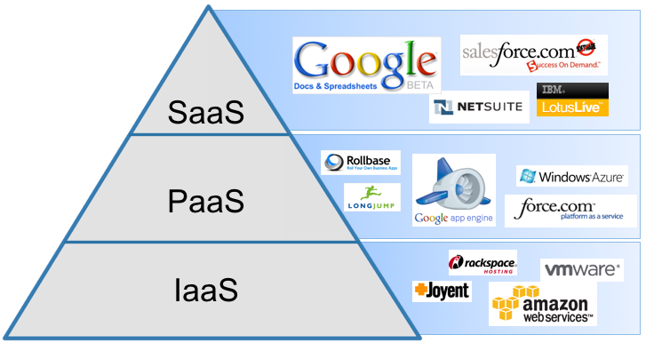
2.4: Cloud Computing Services Examples of Cloud Computing Services

Slide 13
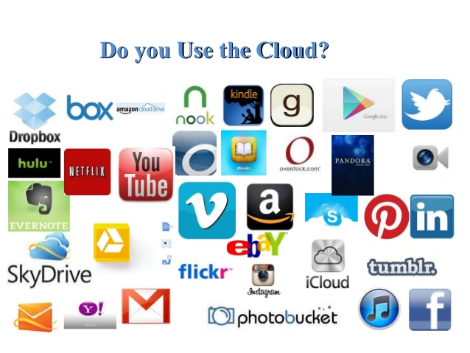
2.4: Cloud Computing Services Examples of Cloud Computing Services

Slide 14
2.5: Advantages Advantages of Cloud
Lower computer cost
Improved performance
Reduced software costs
Instant software updates
Fewer Maintenance issues
Unlimited storage capacity
Increased data reliability
Universal document access
Latest version availability
Easier group collaboration
Device independence

Slide 15
2.6: Disadvantages Disadvantages of Cloud
Requires a constant Internet connection
Does not work well with low-speed connections
Features might be limited
Can be slow
Stored data can be lost
Stored data might not be secure

Slide 16
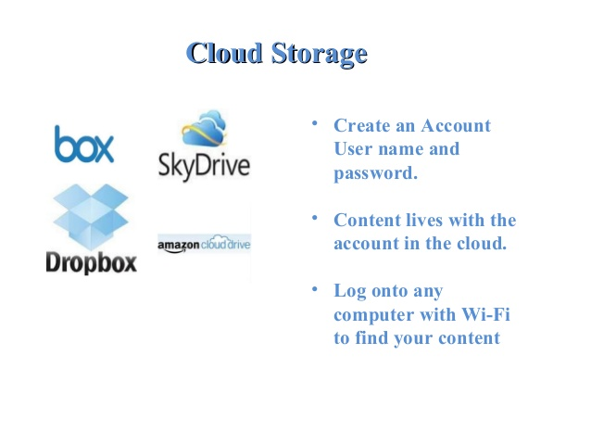
2.7: Cloud Storage Cloud Storage

Slide 17
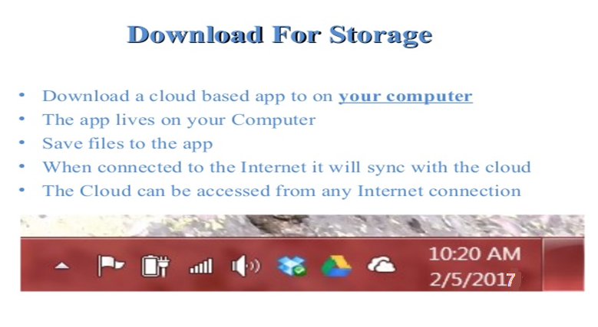
2.7: Cloud Storage Cloud Storage
https://www.slideshare.net/Agarwaljay/cloud-computing-simple-ppt-41561620

Slide 18
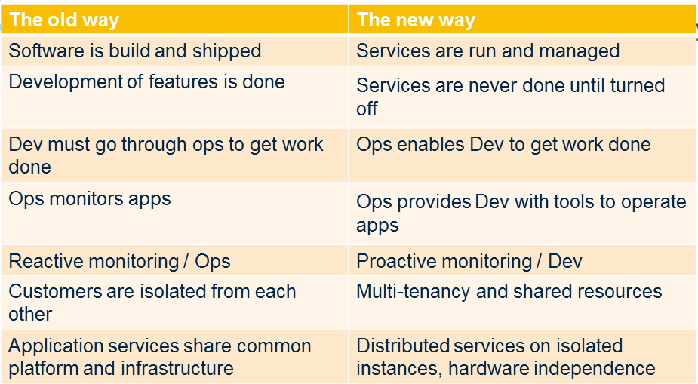
2.8: DevOps and Cloud DevOps and Cloud
As DevOps and cloud become the primary way to build and deploy software, the below table shows the necessary changes

Slide 19
2.8: DevOps and Cloud DevOps and Cloud
DevOps is about streamlining development so user requirements can quickly make it into application production, while the cloud offers automated provisioning and scaling to accommodate application changes
We can reap huge benefits from leveraging DevOps in conjunction with cloud-based platforms
This potent combination can enhance agility and time to market, as well as greatly reduce operating costs

Slide 20
Summary
Cloud provides us a means by which we can access the applications as utilities, over the internet
Cloud Computing refers to manipulating,configuring,and accessing the applications online
Private Cloud, Community Cloud, Public Cloud and Hybrid Cloud are the four types of deployment models
SaaS,Paas and IaaS are the 3 major Cloud Computing services
Notes:
Add the notes here.
Add instructor notes here.

Slide 21
Review Question
Cloud Service consists of
Platform, Software, Infrastructure
Software, Hardware, Infrastructure
Platform, Hardware, Infrastructure
The _________ Cloud allows systems and services to be accessible within an organization
Private Cloud
Public Cloud
Hybrid Cloud
Amazon Web Services is a ________ type of cloud computing distribution model
Software as a Service
Platform as a Service
Infrastructure as a Service
Notes:
Add the notes here.
Question 1: Platform,Software,Infrastructure
Question 2: Private Cloud
Question 3:Infrastructure as a Service

